Slide 1
Analysis Modeling
Requirements analysis
Flow-oriented modeling
Scenario-based modeling
Class-based modeling
Behavioral modeling
(Source: Pressman, R. Software Engineering: A Practitioner’s Approach. McGraw-Hill, 2005)

Slide 2
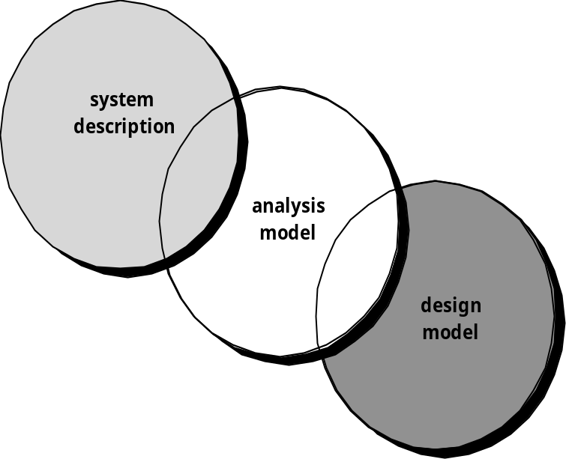
A Bridge
Writing the Software Specification
Everyone knew exactly what had to be done until someone wrote it down!

Slide 3
Goals of Analysis Modeling
Provides the first technical representation of a system
Is easy to understand and maintain
Deals with the problem of size by partitioning the system
Uses graphics whenever possible
Differentiates between essential information versus implementation information
Helps in the tracking and evaluation of interfaces
Provides tools other than narrative text to describe software logic and policy

Slide 4
A Set of Models
Flow-oriented modeling – provides an indication of how data objects are transformed by a set of processing functions
Scenario-based modeling – represents the system from the user's point of view
Class-based modeling – defines objects, attributes, and relationships
Behavioral modeling – depicts the states of the classes and the impact of events on these states

Slide 5
Requirements Analysis

Slide 6
Purpose
Specifies the software's operational characteristics
Indicates the software's interfaces with other system elements
Establishes constraints that the software must meet
Provides the software designer with a representation of information, function, and behavior
  This is later translated into architectural, interface, class/data and component-level designs
Provides the developer and customer with the means to assess quality once the software is built

Slide 7
Overall Objectives
Three primary objectives
  To describe what the customer requires
  To establish a basis for the creation of a software design
  To define a set of requirements that can be validated once the software is built
All elements of an analysis model are directly traceable to parts of the design model, and some parts overlap

Slide 8
Analysis Rules of Thumb
The analysis model should focus on requirements that are visible within the problem or business domain
  The level of abstraction should be relatively high
Each element of the analysis model should add to an overall understanding of software requirements and provide insight into the following
  Information domain, function, and behavior of the system
The model should delay the consideration of infrastructure and other non-functional models until the design phase
  First complete the analysis of the problem domain
The model should minimize coupling throughout the system
  Reduce the level of interconnectedness among functions and classes
The model should provide value to all stakeholders
The model should be kept as simple as can be

Slide 9
Domain Analysis
Define the domain to be investigated.
Collect a representative sample of applications in the domain.
Analyze each application in the sample.
Develop an analysis model for the objects.
In terms of data modeling, function/process modeling, behavioral modeling, etc.
Is this needed also for System Engineering, or for Requirements Analysis only?

Slide 10
Domain Analysis
Definition
  The identification, analysis, and specification of common, reusable capabilities within a specific application domain
  Do this in terms of common objects, classes, subassemblies, and frameworks
Sources of domain knowledge
  Technical literature
  Existing applications
  Customer surveys and expert advice
  Current/future requirements
Outcome of domain analysis
  Class taxonomies
  Reuse standards
  Functional and behavioral models
  Domain languages

Slide 11
Analysis Modeling Approaches
Structured analysis
  Considers data and the processes that transform the data as separate entities
  Data is modeled in terms of only attributes and relationships (but no operations)
  Processes are modeled to show the 1) input data, 2) the transformation that occurs on that data, and 3) the resulting output data
Object-oriented analysis
  Focuses on the definition of classes and the manner in which they collaborate with one another to fulfill customer requirements

Slide 12
Elements of the Analysis Model
Object-oriented Analysis
Structured Analysis
Scenario-based
modeling
Flow-oriented
modeling
Use case text
Use case diagrams
Activity diagrams
Swim lane diagrams
Data structure diagrams
Data flow diagrams
Control-flow diagrams
Processing narratives
Class-based
modeling
Behavioral
modeling
Class diagrams
Analysis packages
CRC models
Collaboration diagrams
State diagrams
Sequence diagrams

Slide 13
Flow-oriented Modeling

Slide 14
Data Modeling
Identify the following items
  Data objects (Entities)
  Data attributes
  Relationships
  Cardinality (number of occurrences)

Slide 15
Data Flow and Control Flow
Data Flow Diagram
  Depicts how input is transformed into output as data objects move through a system
Process Specification
  Describes data flow processing at the lowest level of refinement in the data flow diagrams
Control Flow Diagram
  Illustrates how events affect the behavior of a system through the use of state diagrams

Slide 16
Diagram Layering and Process Refinement
Context-level diagram
Level 1 diagram
Process Specification

Slide 17
Scenario-based Modeling

Slide 18
Writing Use Cases
Writing of use cases was previously described
It is effective to use the first person “I” to describe how the actor interacts with the software
Format of the text part of a use case
Use-case title:
Actor:
Description: I …

Slide 19
Writing Use Cases- Example
Title
  ATM customer withdraws cash
Triggering event
  Card inserted into ATM machine
Description
  Customer withdraws cash from a bank account using an ATM
Pre-conditions
  Account referenced (e.g., checking) is in good standing
  Account balance > withdrawal amount
Post-conditions
  Account has been debited
Basic course of action
  …

Slide 20
Example Use Case Diagram
Make automated menu
selections
Expert Menu
System
Order food and drink
Notify customer that
food and drink are ready
Cook
Customer
Pay for food and drink
Payment
System

Slide 21
Activity Diagrams
Creation of activity diagrams was previously described
Supplements the use case by providing a graphical representation of the flow of interaction within a specific scenario
Uses flowchart-like symbols
  Rounded rectangle - represent a specific system function/action
  Arrow - represents the flow of control from one function/action to another
  Diamond - represents a branching decision
  Solid bar – represents the fork and join of parallel activities

Slide 22
Example Activity Diagram
Set counter = positive n
Set accumulator = initial value
n > 1
F
T
Set accumulator = accumulator * n
Set n = n - 1
F
(n mod 5) == 0
T
Display accumulator value
Return accumulator value

Slide 23
Class-based Modeling

Slide 24
Identifying Analysis Classes
Perform a grammatical parse of the problem statement or use cases
Classes are determined by underlining each noun or noun clause
A class required to implement a solution is part of the solution space
A class necessary only to describe a solution is part of the problem space
A class should NOT have an imperative procedural name (i.e., a verb)
List the potential class names in a table and "classify" each class according to some taxonomy and class selection characteristics
A potential class should satisfy nearly all (or all) of the selection characteristics to be considered a legitimate problem domain class
Potential classes | General classification | Selection Characteristics
(More on next slide)

Slide 25
Identifying Analysis Classes
(continued)
General classifications for a potential class
  External entity (e.g., another system, a device, a person)
  Thing (e.g., report, screen display)
  Occurrence or event (e.g., movement, completion)
  Role (e.g., manager, engineer, salesperson)
  Organizational unit (e.g., division, group, team)
  Place (e.g., manufacturing floor, loading dock)
  Structure (e.g., sensor, vehicle, computer)
(More on next slide)

Slide 26
Identifying Analysis Classes (continued)
Six class selection characteristics
  Retained information
    Information must be remembered about the system over time
  Needed services
    Set of operations that can change the attributes of a class
  Multiple attributes
    Whereas, a single attribute may denote an atomic variable rather than a class
  Common attributes
    A set of attributes apply to all instances of a class
  Common operations
    A set of operations apply to all instances of a class
  Essential requirements
    Entities that produce or consume information

Slide 27
Defining Attributes of a Class
Attributes of a class are those nouns from the grammatical parse that reasonably belong to a class
Attributes hold the values that describe the current properties or state of a class
An attribute may also appear initially as a potential class that is later rejected because of the class selection criteria
In identifying attributes, the following question should be answered
  What data items (composite and/or elementary) will fully define a specific class in the context of the problem at hand?
Usually an item is not an attribute if more than one of them is to be associated with a class

Slide 28
Defining Operations of a Class
Operations define the behavior of an object
Four categories of operations
  Operations that manipulate data in some way to change the state of an object (e.g., add, delete, modify)
  Operations that perform a computation
  Operations that inquire about the state of an object
  Operations that monitor an object for the occurrence of a controlling event
An operation has knowledge about the state of a class and the nature of its associations
The action performed by an operation is based on the current values of the attributes of a class
Using a grammatical parse again, circle the verbs; then select the verbs that relate to the problem domain classes that were previously identified

Slide 29
Example Class Box
Class Name
Component
+ componentID
- telephoneNumber
- componentStatus
- delayTime
- masterPassword
- numberOfTries
Attributes
+ program()
+ display()
+ reset()
+ query()
- modify()
+ call()
Operations

Slide 30
Association, Generalization and Dependency (Ref: Fowler)
Association
  Represented by a solid line between two classes directed from the source class to the target class
  Used for representing (i.e., pointing to) object types for attributes
  May also be a part-of relationship (i.e., aggregation), which is represented by a diamond-arrow
Generalization
  Portrays inheritance between a super class and a subclass
  Is represented by a line with a triangle at the target end
Dependency
  A dependency exists between two elements if changes to the definition of one element (i.e., the source or supplier) may cause changes to the other element (i.e., the client)
  Examples
    One class calls a method of another class
    One class utilizes another class as a parameter of a method

Slide 31
Example Class Diagram
Accountant
Auditor
Record
Keeper
Input
Verifier
Production
Manager
Transaction
Processor
Error Log
Input Handler
Report
Generator
Account List
Account
1..n
Local File
Handler
Remote File
Handler
Accounts
Receivable
Accounts
Payable

Slide 32
Behavioral Modeling

Slide 33
Creating a Behavioral Model
Identify events found within the use cases and implied by the attributes in the class diagrams
Build a state diagram for each class, and if useful, for the whole software system

Slide 34
Identifying Events in Use Cases
An event occurs whenever an actor and the system exchange information
An event is NOT the information that is exchanged, but rather the fact that information has been exchanged
Some events have an explicit impact on the flow of control, while others do not
  An example is the reading of a data item from the user versus comparing the data item to some possible value

Slide 35
Building a State Diagram
A state is represented by a rounded rectangle
A transition (i.e., event) is represented by a labeled arrow leading from one state to another
  Syntax: trigger-signature [guard]/activity
The active state of an object indicates the current overall status of the object as is goes through transformation or processing
  A state name represents one of the possible active states of an object
The passive state of an object is the current value of all of an object's attributes
  A guard in a transition may contain the checking of the passive state of an object

Slide 36
Example State Diagram
pop / set n to 0; return error
push [n – 2 < max]
push [n = 0]
Empty
Stack
Partially
Filled Stack
pop [n > 1]
pop [n = 1]
pop [n = max]
push [n - 1 = max]
Full Stack
push / set n to max; return error

Slide 37
Summary:
Elements of the Analysis Model
Object-oriented Analysis
Structured Analysis
Scenario-based
modeling
Flow-oriented
modeling
Use case text
Use case diagrams
Activity diagrams
Swim lane diagrams
Data flow diagrams
Control-flow diagrams
Processing narratives
Class-based
modeling
Behavioral
modeling
Class diagrams
Analysis packages
CRC models
Collaboration diagrams
State diagrams
Sequence diagrams
☺

